Slide 1
Chapter 4: Business Process and Functional Modeling

Slide 2
Objectives
Understand the process used to identify business processes and use cases.
Understand the process used to create use-case diagrams
Understand the process used to model business processes with activity diagrams.
Understand the rules and style guidelines for activity diagrams.
Understand the process used to create use case descriptions.
Understand the rules and style guidelines for use case descriptions.
Be able to create functional models of business processes using use-case diagrams, activity diagrams, and use case descriptions.
Notes:
Use case modeling shows how users view a business process independent of its internal mechanisms or the other systems it is dependent on. Business processes are usually depicted with three views. What are the three views?
What models are used to represent the functional view of a process?
Are use case descriptions / narratives, use case diagrams & activity diagrams. logical or physical?

Slide 3
Introduction
Now begin the process of turning the requirements into functional models
Models are logical; i.e., independent of how they are implemented (manual or computerized)
Develop use-cases from the requirements
Use-case: how a business system interacts with its environment
Includes a diagram and a description to depict the discrete activities that the users perform
Develop activity diagrams from the use-cases
These model the business processes or how a business operates
Used to illustrate the movement of objects (data) between activities
Notes:
Why is business process modeling important?

Slide 4




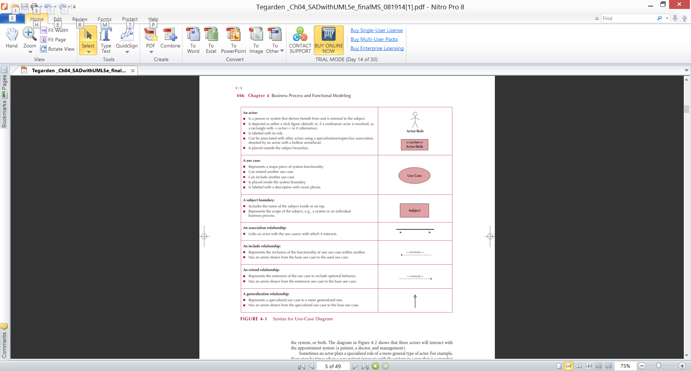
Business Process Identification With Use-Cases
Elements of Use-Case Diagrams
Actors: users or other interacting systems
Associations: lines to connect actors and use-cases
Interactions, inclusions, extensions or generalizations
Use-case: a major process in the system that gives a benefit to the users
Subject boundary: a named box that depicts the scope of the system
An association relationship: links an actor with the use case(s) with which it interacts
Notes:
What relationships are the key elements of Use-Case Diagrams?
What is the subject boundary?

Slide 5
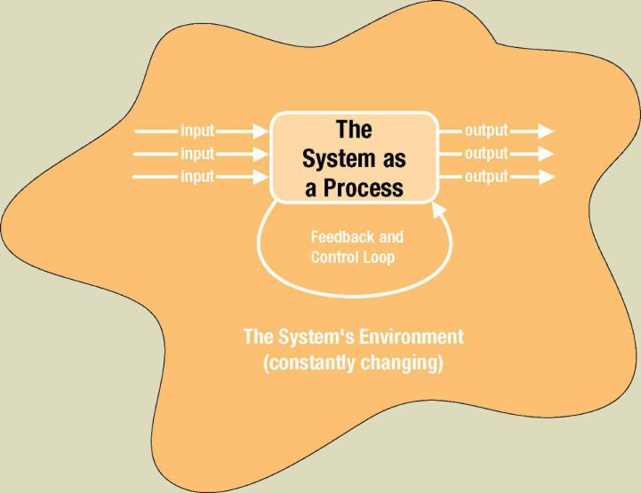
The System is Itself a Process
Notes:
Since systems environments are constantly changing, the trick is to design systems that adapt to change. What do we build into systems that monitor them & allow them to change?
What does the star shaped line represent?
Where does a system get its inputs from and provide its outputs to?

Slide 6
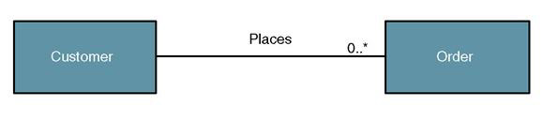
Object/Class Relationships
Object/class relationship – a natural business association that exists between one or more objects and classes.
Notes:
Why do we care about relationships?
How do we illustrate a relationship?
Is the above bidirectional
Must an instance of order exist for each instance of customer?
Must an instance of customer exist for each instance of order?
For each instance of customer how many instances of order can exist?
For each instance of order how many instances of customer can exist?
Can an object send a message to any other object?

Slide 7
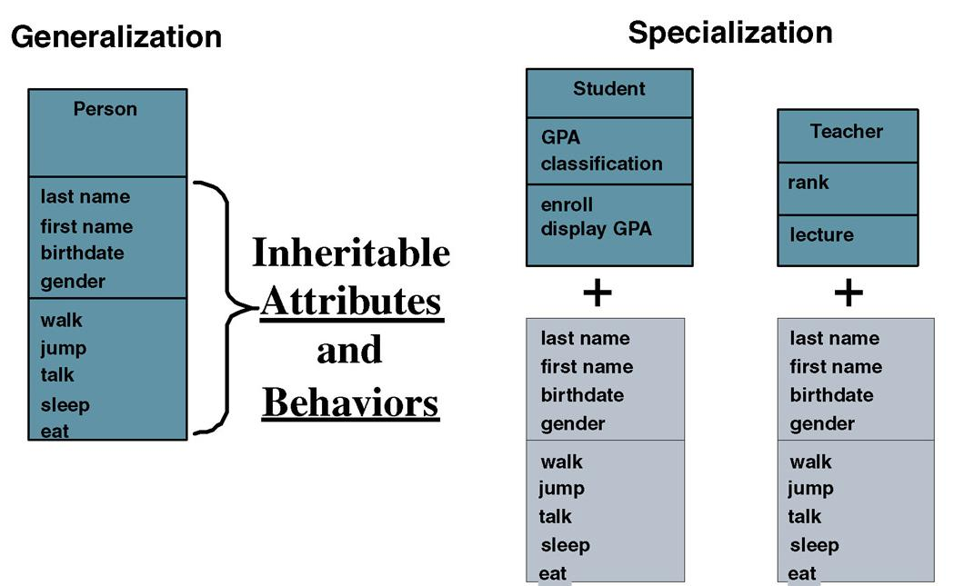
Notes:
Inheritance is critical to object orientation & in fact defines it. Languages & databases must support it to be considered object oriented. What attributes & behaviors do students & teachers inherit from Person?
Where is GPA in person?
Person includes all the attributes & behaviors in the bottom portion of the other two & the specialized Student sub type also has what?
What behaviors do Person, Student & Teacher share?

Slide 8
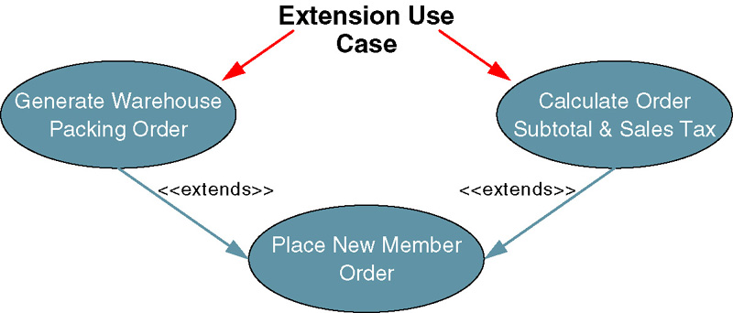
Use Case Extend Relationship
Extension use case –use case consisting of steps extracted from another use case to simplify the original.
Extends the functionality of the original use case.
Generally not identified in the requirements phase
Extends relationship represented as arrow beginning at the extension use case and pointing to use case it is extending.
Labeled <<extends>>.
Notes:
If a use case contains complex functionally consisting of several steps, we can make the use case more easily understood by extracting the more complex steps into their own use case. Who can give some examples?
Extend relationships broaden the use case to include optional behavior. What is another example of an extend use case?

Slide 9
Why is business process modeling important?

Slide 10
Why do we care about relationships?

Slide 11
Extend relationships broaden the use case to include optional behavior. What is an example of an extend use case?

Slide 12
Define Object Modeling.

Slide 13
Distinguish between the extend and include relationships in use case diagrams.

Slide 14
Identifying Major Use-Cases
Review the requirements definition
Identify the subject’s boundaries
Identify the primary actors and their goals
Identify the business processes and major use-cases
Carefully review the current set of use-cases
Split or combine some to create the right size
Identify additional use-cases
Notes:
This slide lists the 5 steps that are used to identify the use cases we will use to model our “to be” system.
Why do we strive to have about three to nine major use cases in a business process?
Why is iteration important in creating use cases?

Slide 15
Create a Use-Case Diagram
Place & draw the use-cases
Place & draw the actors
Draw the subject boundary
Add the associations
Notes:
How is use case diagramming related to functional modeling?
What are some guidelines for creating a use case diagram?
What problem does use case modeling solve for the systems analyst?
What is the difference between use case diagrams & narratives?
Is the use case a functional requirement?.

Slide 16
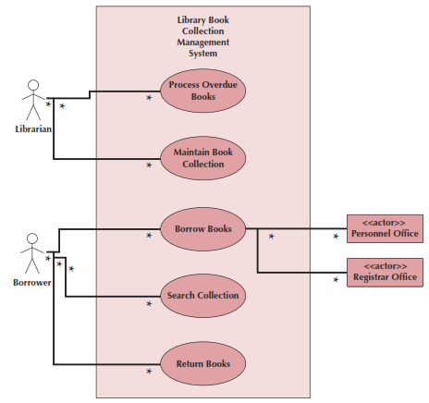
Example Use-Case
Library Book Collection
Management System
Use Case Diagram
Notes:
Describe actor to a non IT savvy stakeholder?
Describe Use Case to a non IT savvy stakeholder?
Describe System Boundary to a non IT savvy stakeholder?
Describe Relationship to a non IT savvy stakeholder?
Associations are depicted with the black line on this slide. What do all the black lines (Associations) have in common?

Slide 17
Activity Diagram Syntax
Action or Activity
Represents action or set of actions
Control Flow
Shows sequence of execution
Initial Node
The beginning of a set of actions
Final Node
Stops all flows in an activity
Decision Node
Represents a test condition
Notes:
What do Business processes consist of?
What do activity diagrams do?
Can they be used for any type of process?
What is the purpose of an activity diagram?
Why do we model business processes?

Slide 18
Elements of an Activity Diagram
Actions & Activities
Something performed for some specific business reason
Named with a verb and a noun (e.g., Get Patient Information)
Activities can be further sub-divided; actions cannot
Object Nodes: represent the flow of information from one activity to another
Control Flows: model execution paths
Object Flows: model the flow of objects
Control Nodes: 7 types
Notes:
What is the difference between an activity and an action?
What do object nodes do?

Slide 19
Control Nodes
Initial node: the beginning of the set of actions/activities
Final-activity node: stops all actions/activities
Final-flow node: stops one execution path but allows others to continue
Decision node: represents a test to determine which path to use to continue (based on a guard condition)
Merge node: rejoins mutually exclusive execution paths
Fork node: separates a single execution path into one or more parallel paths
Join node: rejoins parallel execution paths
Notes:
This slide lists the seven (7) different types of control nodes that can be found on activity diagrams. What does a decision node represent?
What is a guard condition?

Slide 20
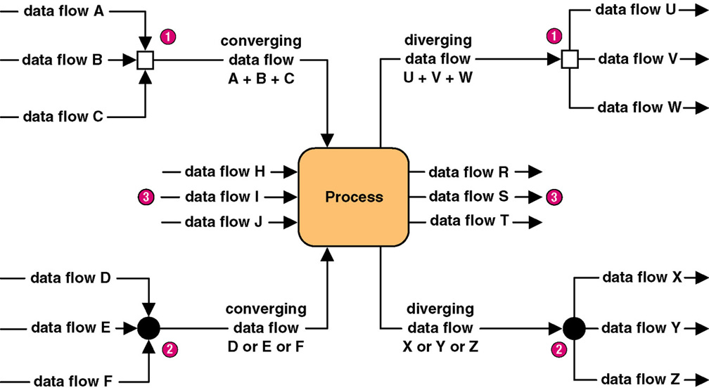
Diverging and Converging Data Flows
Notes:
What is the purpose of a fork node?.
Data flows are like stocks. Why? .
Data flows are like companies. Why?
What does the symbol (empty, now colored square) signify?
What does the symbol (solid, black circle) signify?
NB: Some case tools use different notations.

Slide 21
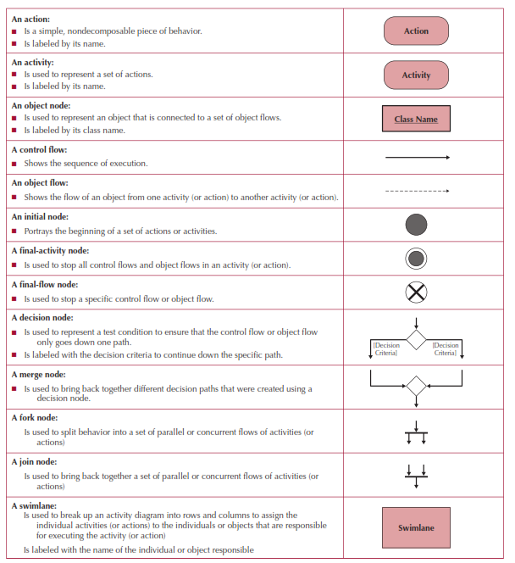
Activity Diagram Symbols
Notes:
How many different types of control nodes are in an activity diagram?
What I the difference between a Final Activity node and a Final Flow node?
What I the difference between a Merge node and a Join node?

Slide 22
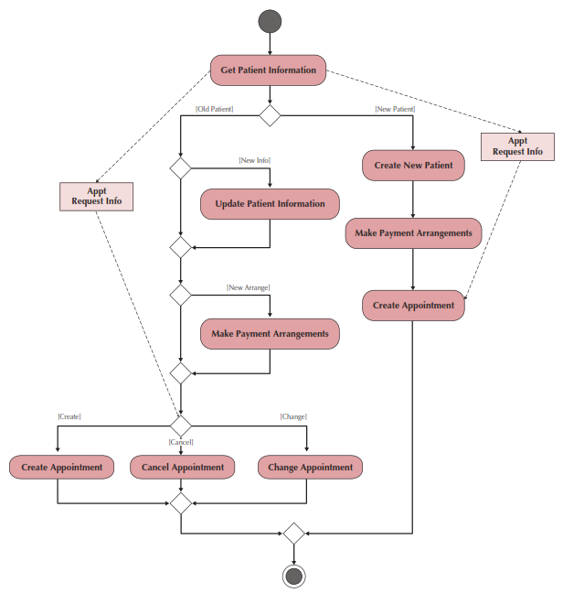
Sample Activity Diagram
Notes:
What is the difference between a control flow and an object flow?
What does the circle surrounded by small filled inn circle represent?

Slide 23
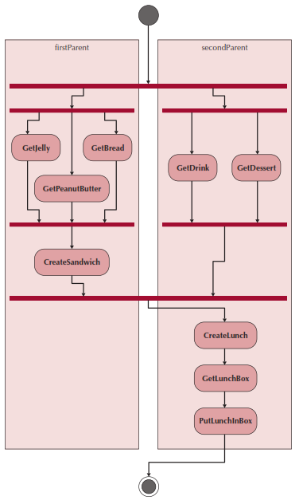
Swim lanes
Used to assign responsibility to objects or individuals who actually perform the activity
Represents a separation of roles among objects
Can be drawn horizontally or vertically
Notes:
When we say “Used to assign responsibility to objects or individuals who actually perform the activity” what does that mean?

Slide 24
Creating an Activity Diagram
Choose a business process identified previously
Review the requirements definition and use-case diagram
Review other documentation collected thus far
Identify the set of activities used in the business process
Identify control flows and nodes
Identify the object flows and nodes
Lay out & draw the diagram (minimize crossing lines)
Notes:
What must we do before create an Activity Diagram?

Slide 25
Why is iteration important in creating use cases?

Slide 26
What problem does use case modeling solve for the systems analyst?

Slide 27
What is the difference between use case diagrams & narratives?

Slide 28
Is a use case a functional requirement?

Slide 29
Describe Use Case to a non IT savvy stakeholder?

Slide 30
What is the difference between an activity and an action?

Slide 31
Control flows in an activity diagram are shown using solid-lines with arrows while object flows are shown using dashed lines with arrows.
T / F ?

Slide 32
The event that causes a use case to begin is called a(n) _____.
a. action
b. trigger
c. hammer
d. anvil
e. stakeholder

Slide 33
A scenario is the same as a(n) _____.
a. use case
b. relationship
c. path through a use case
d. collection of use cases
e. role

Slide 34
Use Cases
The primary driver for all UML diagramming techniques
Depicts activities performed by the users
Describe basic functions of the system:
What the user can do
How the system responds
Use cases are building blocks for continued design activities
Each use-case describes 1 and only 1 function
Notes:
What is the viewpoint of a use case, and why is it important?
What do use cases “communicate” to the analyst?
Are there any rules that apply to use cases?

Slide 35
Types of Use Cases
Purpose | Amount of information
 |  | Overview | Detail
 | Essential | High-level overview of issues essential to understanding required functionality | Detailed description of issues essential to understanding required functionality
 | Real | High-level overview of a specific set of steps performed on the real system once implemented | Detailed description of a specific set of steps performed on the real system once implemented
Notes:
How does a detail use case differ from an overview use case?
How does an essential use case differ from a real use case?

Slide 36
Elements of a Use Case Description
Overview:
Name, ID Number, Type, Primary Actor, Brief Description, Importance Level, Stakeholder(s), Trigger(s)
Relationships:
Association: Communication between the use case and the actors
Extend: Extends the functionality of a use case
Include: Includes another use case
Generalization: Allows use cases to support inheritance
Flow of events
Normal flow: the usual set of activities
Sub-flows: decomposed normal flows to simplify the use-case
Alternate or exceptional flows: those not considered the norm
Optional characteristics (complexity, time, etc.)
Notes:
In addition to those listed on this slide, what other major elements could be included in a detailed use case description?
Where do we start when we are trying to determine the set of use cases we will model?
How does a use case description relate to structural & behavioral diagrams?

Slide 37
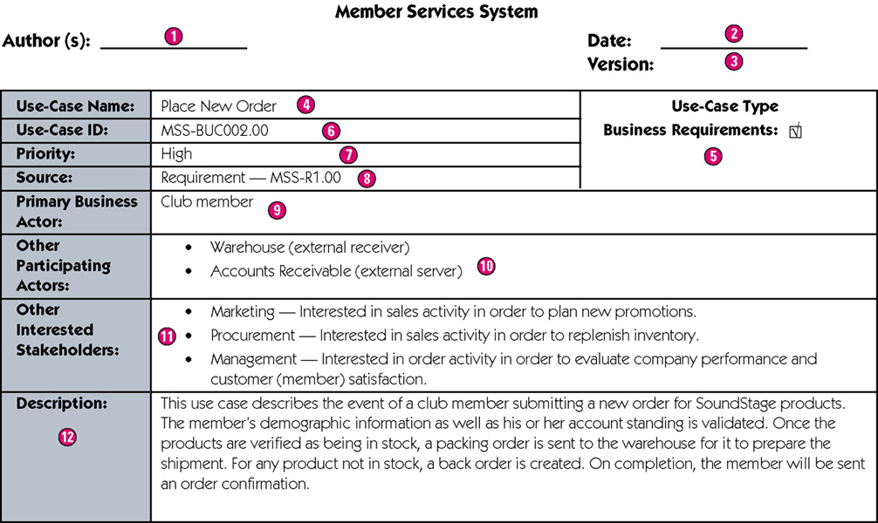
Sample High-Level Version of a Use-Case Narrative
Notes:
Why do we document at a high level first?
Why #3 (version)?
What does #8 (the source) do?
Who is the primary business actor (#9)?

Slide 38
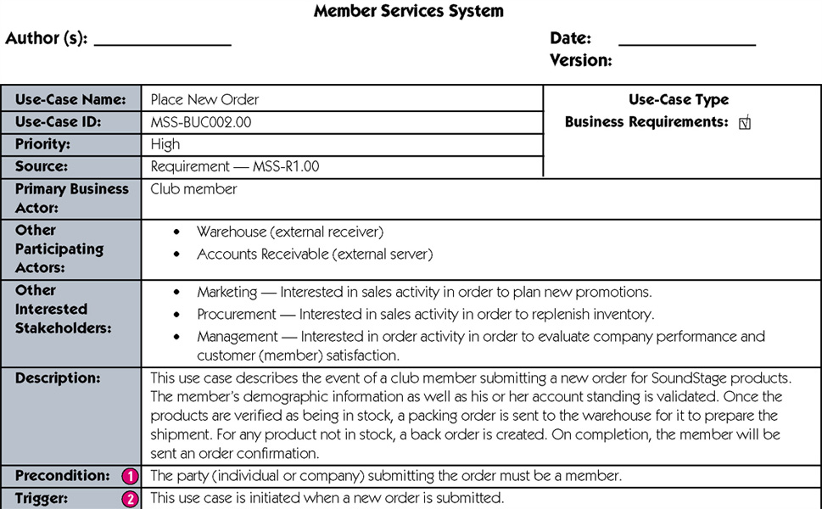
Sample Expanded Version of a Use-Case Narrative
continued
Notes:
What is included in the expanded version?
What is a precondition?

Slide 39
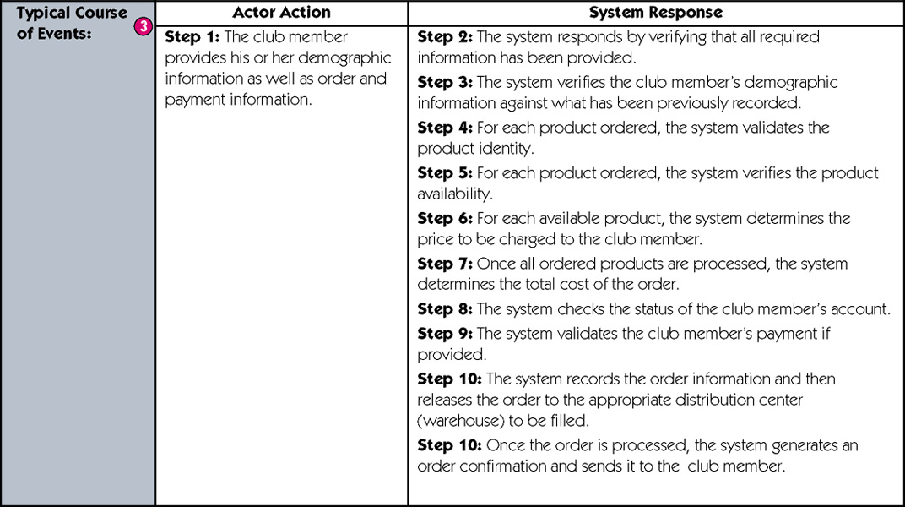
Sample Expanded Version of a Use-Case Narrative (cont)
continued
Notes:
What does the “typical course of events” consist of?

Slide 40
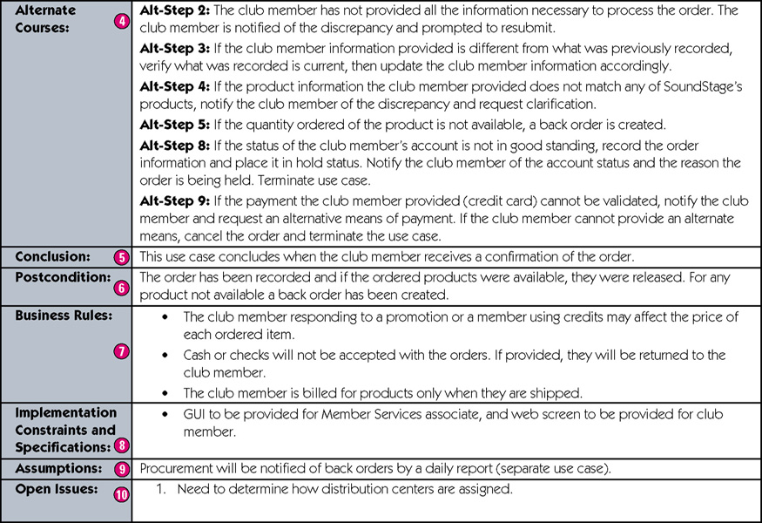
Sample Expanded Version of a Use-Case Narrative (cont)
concluded
Notes:
How do you define “post condition”?
What are “Business Rules”?
What are “implementation constraints & specifications”?
How long can “open issues” be opened?
.

Slide 41
Creating Use-Case Descriptions
Pick a high priority use-case and create an overview:
List the primary actor
Determine its type (overview or detail; essential or real)
List all stakeholders and their interests
Determine the level of importance of the use-case
Briefly describe the use-case
List what triggers the use-case
List its relationship to other use-cases
Fill in the steps of the normal flow of events required to complete the use-case
Notes:
What are some the guidelines used when we write a use case?

Slide 42
Creating Use-Case Descriptions (cont.)
Ensure that the steps listed are not too complicated or long and are consistent in size with other steps
Identify and write the alternate or exceptional flows
Carefully review the use-case description and confirm that it is correct
Iterate over the entire set of steps again
Notes:
What is a alternate or exception flow?

Slide 43
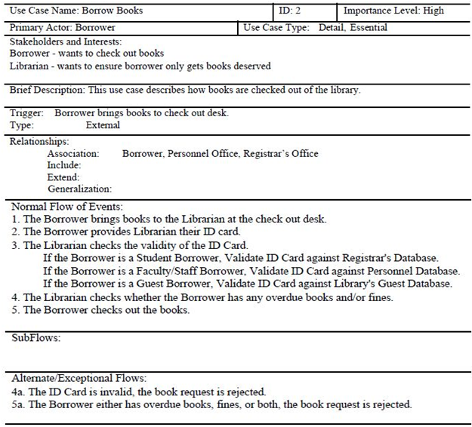
Example Use-Case Description
Notes:
Who are the actors in this use case?
Are there any Generalization or Inheritance opportunities?
Are there any Extend opportunities?

Slide 44
Verifying & Validating a Use-Case
Use-cases must be verified and validated before beginning structural and behavioral modeling
Notes:
If I compare an activity diagram to a use-case description, what should I be looking for?
If I compare a use-case description to a use-case diagram, what should I be looking for?
Are there any diagram-specific requirements?

Slide 45
Verifying & Validating a Use-Case
Utilize a walkthrough:
Perform a review of the models and diagrams created so far
Performed by individuals from the development team and the client (very interactive)
Facilitator: schedule and set up the meeting
Presenter: the one who is responsible for the specific representation being reviewed
Recorder (scribe) to take notes and especially to document errors
Notes:
What is a walkthrough? How does it relate to verification and validation?
What are the different roles played during a walk-through?

Slide 46
Rules for Verification & Validation
Ensure one recorded event in the flows of the use-case description for each action/activity on the activity diagram
All objects in an activity diagram must be mentioned in an event of the use-case description
The sequence of the use-case description should match the sequence in the activity diagram
One and only one description for each use-case
All actors listed in a use-case description must be shown on the use-case diagram
Stakeholders listed in the use-case description may be shown on the use-case diagram (check local policy)
All relationships in the use-case description must be depicted on the use-case diagram
All diagram-specific rules must be enforced
Notes:
What is CRUD? Why is this useful for Verification & Validation?

Slide 47
Benefits of Use-Case Modeling
Provides tool for capturing functional requirements.
Assists in decomposing system into manageable pieces.
Provides means of communicating with users/stakeholders concerning system functionality in language they understand.
Provides means of identifying, assigning, tracking, controlling, and management system development activities.
Provides aid in estimating project scope, effort, and schedule.
Notes:
By looking at this list you can see use cases model functionality. They are the starting point for identifying data entries or objects of a system. They are a resource for validating & testing a design. What is the core requirement for a successful use case?

Slide 48
Benefits of Use-Case Modeling (continued)
Aids in defining test plans and test cases.
Provides baseline for user documentation.
Provides tool for requirements traceability.
Provides starting point for identification of data objects or entities.
Provides specifications for designing user and system interfaces.
Provides means of defining database access requirements.
Provides framework for driving the system development project.
Notes:
From which viewpoint is the system’s functionally developed?
What impact does it have on communication?

Slide 49
Define the term “actor”. Give an example.

Slide 50
Who is the actor that initiates a “temporal event”?

Slide 51
Read the class Handout
(mini case)

Slide 52
Identify possible actors for this Mini Case

Slide 53
Identify possible use cases for this Mini Case

Slide 54
Read the class Handout
(mini case)

Slide 55
Define an actor and describe the associated use case
You are meeting with the management team tomorrow morning and want to present to them an initial draft of your first model (a descriptive diagram). What / who will your model include?

Slide 56
Define an actor and describe the associated use case

Slide 57
You are meeting with the management team tomorrow morning and want to present to them an initial draft of your first model (a descriptive diagram). What / who will your model include?

Slide 58
Read the class Handout
(mini case)

Slide 59
Could Amazon.com achieve business success without information technology? Why or why not?
Can any business today succeed without information technology? Why or why not?
Jeff Bezos says that: “The trouble with most corporations is that they make judgment-based decisions, when data-based decisions could be made.” Do you agree or not? Explain.

Slide 60
Could Amazon.com achieve business success without information technology? Why or why not?

Slide 61
Can any business today succeed without information technology? Why or why not?

Slide 62
Jeff Bezos says that: “The trouble with most corporations is that they make judgment-based decisions, when data-based decisions could be made.” Do you agree or not? Explain.
Notes:
No answer. Either you do or you do not!!

Slide 63
Read Mini Case
#1 page #161

Slide 64
Explain, in clear, nontechnical terms, the goals of the analysis of the project.

Slide 65
Explain, in clear, nontechnical terms, how use cases and a use-case diagram will be used by the project team.

Slide 66
What do use cases and use case diagrams represent in the system?

Slide 67
How will use cases and use case diagrams be used by the project team.

Slide 68
Read Mini Case
#2 page #161 & #162

Slide 69
Create a set of activity diagrams for the business process described here.

Slide 70
Briefly describe the purposes of use case modeling in software development.

Slide 71
What is a walkthrough?

Slide 72
Explain the difference between normal flows and sub-flows that would be documented in a use case.

Slide 73
Distinguish between the association and generalization relationships in use case diagrams.

Slide 74
Verification and validation through a walkthrough is to uncover and correct errors or faults in the evolving specification.
T / F?

Slide 75
Setting the scope of the activity being modeled is a task that can be accomplished after completing the activity diagram. T / F

Slide 76
The use case Take Order has a temporal trigger if it begins when a customer calls to place an order. T / F?

Slide 77
A use case that describes functionality that is complex and risky would be given a high importance level.
T / F?

Slide 78
A(n) ___________ actor is a separate system that interacts with the current system using standard communication protocols, such as TCP/IP, FTP, or HTTP, or an external database that can be accessed using standard SQL.
a. incremental
b. simple
c. open
d. average
e. complex

Slide 79
If a use case becomes too complex, it should be _____.
a. rewritten to simplify it
b. decomposed into a set of use cases
c. written with a series of repeating steps to simplify it
d. written from the perspective of an independent observe to simplify it
e. dropped from the system, as it will be too complex to implement in the final system

Slide 80
Jim has documented a use case that describes the functionality of a system as “To compute gross pay, multiply the hours worked that are recorded on the time card from the time clock by the hourly rate that is recorded in the employee master file from the MS SQL server database.” This is an example of a(n) _____ use case.
a. overview
b. detail
c. essential
d. real
e. imaginary

Slide 81
Business processes are usually depicted with three views. What are the three views?

Slide 82
What models are used to represent the functional view of a process?

Slide 83
Are use case descriptions / narratives, use case diagrams & activity diagrams. logical or physical?

Slide 84
What is the subject boundary?

Slide 85
What do object nodes do?

Slide 86
What do we build into systems that monitor them & allow them to change?

Slide 87
Where does a system get its inputs from and provide its outputs to?

Slide 88
Why do we model business processes?

Slide 89
What does a decision node represent?

Slide 90
What is a guard condition?

Slide 91
What do use cases “communicate” to the analyst?

Slide 92
How does a use case description relate to structural & behavioral diagrams?

